Slide 1
Blind’s Eye : IoT based real-time surrounding identification
and object detection
^{HIMANSHU SHEKHAR} ENROLMENT NO. : 12017002002067 ^{SUJOY SEAL} ENROLMENT NO. : 12017002002010
^{Under the supervision of} PROF. TUFAN SAHA
Department of Computer Science and Engineering Institute of Engineering and Management

Slide 2
CONTENTS
 | TITLE |  | PAGE NUMBER
 | PROBLEM |  | 3
 | INTRODUCTION |  | 4
 | APPROACH |  | 5
 | ML MODEL |  | 6
 | CODE SNIPPET |  | 7
 | SECURITY |  | 8
 | OUTPUT |  | 9
 | STATUS |  | 10
 | REFERENCES |  | 11

Slide 3
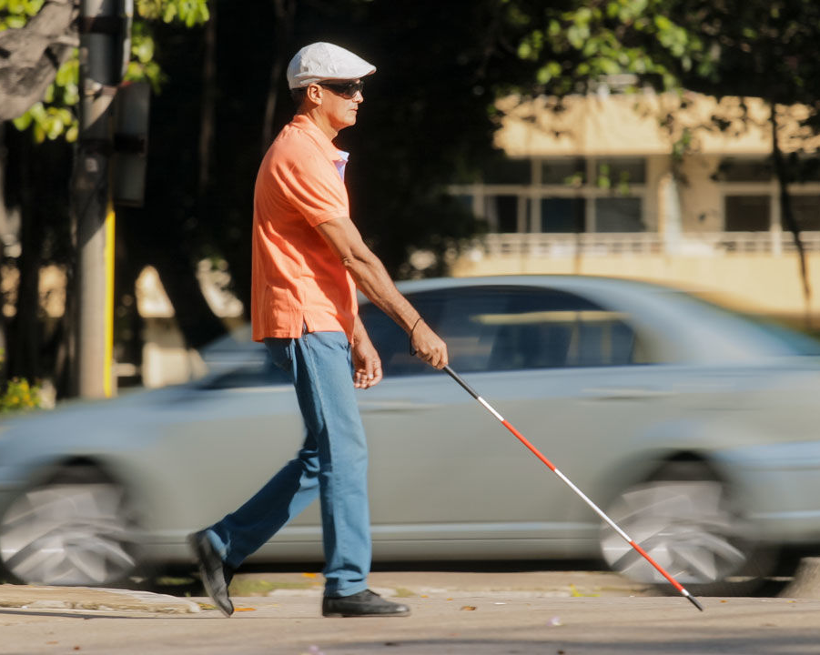
PROBLEM
39 million people are blind. ⁽²⁾
They are helpless.
Fig. 1. A visually impaired person crossing street. ⁽¹⁾

Slide 4
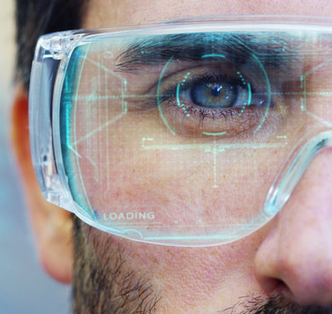
INTRODUCTION
I’m blind but not deaf.
For example, if the user is crossing a road and he gets the information that a car is approaching to him with 40 miles/hr, he can either move left or right to save himself.
Fig. 2. A man with a futuristic look with glasses augmented reality in holography. ⁽³⁾

Slide 5
APPROACH
Fig. 3. A block diagram showing the process for providing surrounding information to the user.

Slide 6
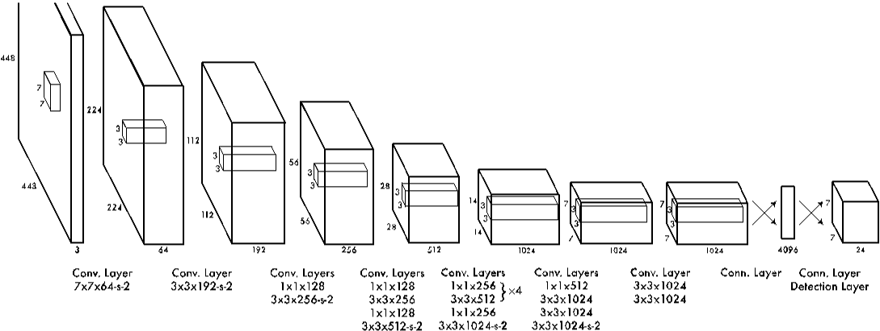
ML MODEL
Fig. 4. Diagram shows the layers of the network ⁽⁴⁾
The architecture of the network is a series of convolutional layers followed by fully connected layers.

Slide 7
CODE SNIPPET
1. #Extracting features to detect objects
2.
3.blob=cv2.dnn.blobFromImage(img,0.00392,(416,416),(0,0,0),True,crop=False)
4. #Inverting blue with red
5. #bgr->rgb 6. 7. #We need to pass the img_blob to the algorithm
8.
9. net.setInput(blob)
10. outs=net.forward(output_layers)
11.
12. #print(outs)

Slide 8
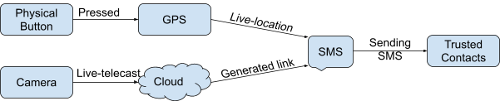
SECURITY
Fig. 5. A block diagram depicting security aspect embedded in the device

Slide 9
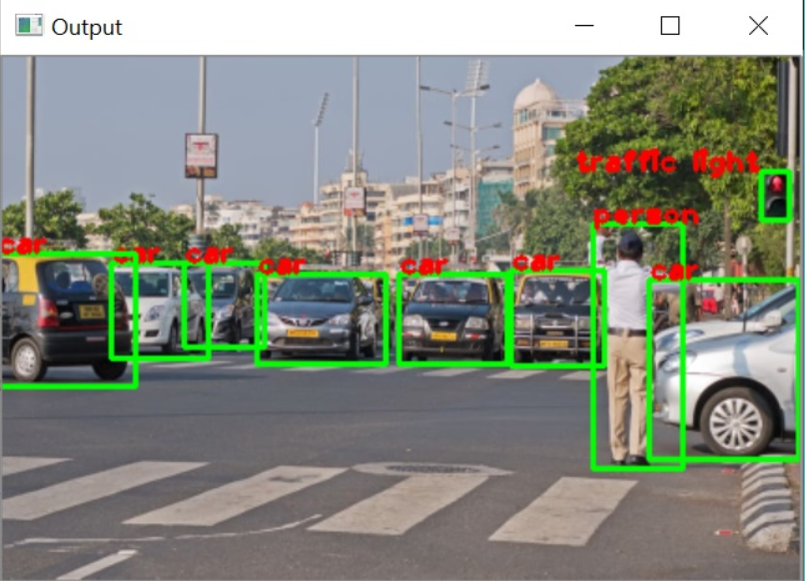
OUTPUT
Fig. 6. Intermediary output of the model

Slide 10
FUTURE IMPLEMENTATION
Need to implement hardware for making system portable.
Plan of Action : Raspberry Pi 3 with Raspbian or Noobs.
Need to implement for a varied dataset
Plan of Action : Gather More dataset.
Use of CNN with more neurons instead of Open CV
Plan of Action : Modify existing Algorithm

Slide 11
REFERENCES
Servick K. Echolocation in blind people reveals the brain’s adaptive powers. Science Mag. (Oct. 1, 2019). https://www.sciencemag.org/news/2019/10/echolocation-blind-people-reveals-brain-s-adaptive-powers. [Last accessed on: Jun. 5, 2021]
Pascolini D, Mariotti SPM. Global estimates of visual impairment: 2010. British Journal Ophthalmology Online First published December 1, 2011 as 10.1136/bjophthalmol-2011-300539.
HQUALITY. A man with a futuristic look with glasses augmented reality in holography. Adobe Stock. (n.d.). FILE #: 145565083. https://stock.adobe.com/in/search?k=futuristic+glasses. [Last accessed on: Jun. 5, 2021]
Redmon, Joseph, et al. "You only look once: Unified, real-time object detection." Proceedings of the IEEE conference on computer vision and pattern recognition. 2016. [Last accessed on: Jun. 6, 2021]

Slide 12
THANK YOU 😊

